Slide 1
Progress Update
Andrew McVeigh
Oct 25th 2005

Slide 2
Visualisation of Backbone Models

Slide 3
Model of Backbone
Alloy model (without redefs) is complete
  20 or so rules, metamodel has 13 Sigs
  Can generate complex (counter)examples
Now working on redefinitions
  Reading papers on reconfiguration (see later slides)

Slide 4
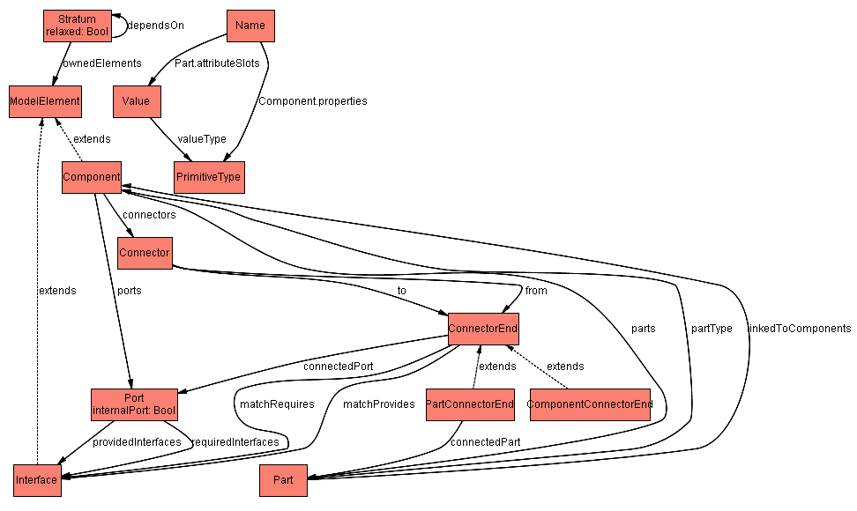
Backbone MetaModel in Alloy
Auto generated from Alloy

Slide 5
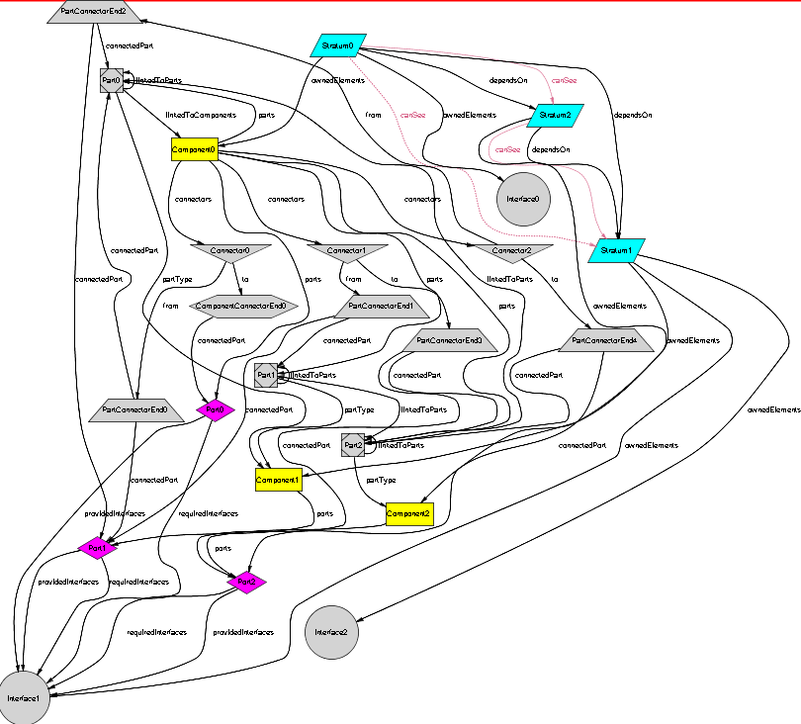
A model in Alloy
Alloy has some visual tweaks
But models get complex very quickly

Slide 6
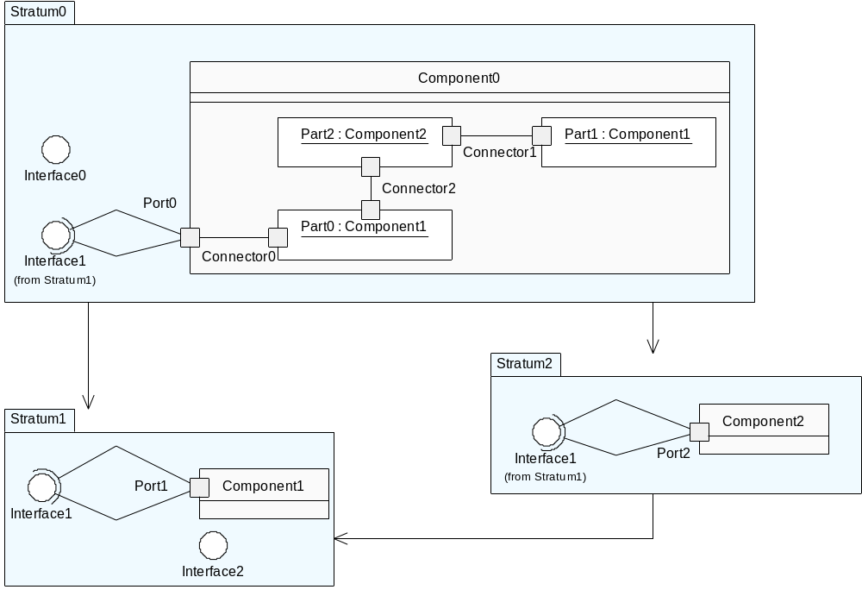
The same model in jUMbLe
Have written an automated import facility into UML → much easier to analyse

Slide 7
Literature Search

Slide 8
Search focus
So far, have looked at
  Reconfiguration of ADLs & ADLs in general
    Most literature focuses on dynamic aspect
  OO Frameworks and their problems
    Definitions: lots of literature here
    Contract languages, constraints etc.
    Evaluation of reusability
  Control mechanisms
    LGI, units of behavioural composition
  Most relevant papers so far:
    “Encapsulation of Structural Adaptation by Composite Components”: Steffen Grobel, 2004
    Possibly “Invasive Software Composition” → waiting on book

Slide 9
Next papers to read
(over weekend)
Reconfiguration
  Algebraic & graph-based architectural reconfiguration
  Building Reconfig Primitives into the Law of a System (LGI: Minsky)
  Aspects as a form of graph rewriting
ADLs
  Conic, C2
Control
  HorCom
Composition of software

Slide 10
Current Thinking…

Slide 11
My (current) thoughts
Reconfiguration is just a mechanism
  Focus on combining reconfigurations
    Can we say anything general about this?
    Is there a way to express reconfigs to guarantee properties?
    If not, what can we detect?
Reconfiguration of control
  What is the unit of composition of control?
    FSP? State machines?
  Can we use reconfiguration to adjust this also
i.e. reconfiguration of structure and behaviour

